Slide 1
The Silver screen
Luis Garcia, Audrey Lamb, Choi wa tsang, Laytoamb Wiggins

Slide 2

The silver screen
What makes a good movie?
Why are movies always in demand?
What determines the success of a movie?

Slide 3
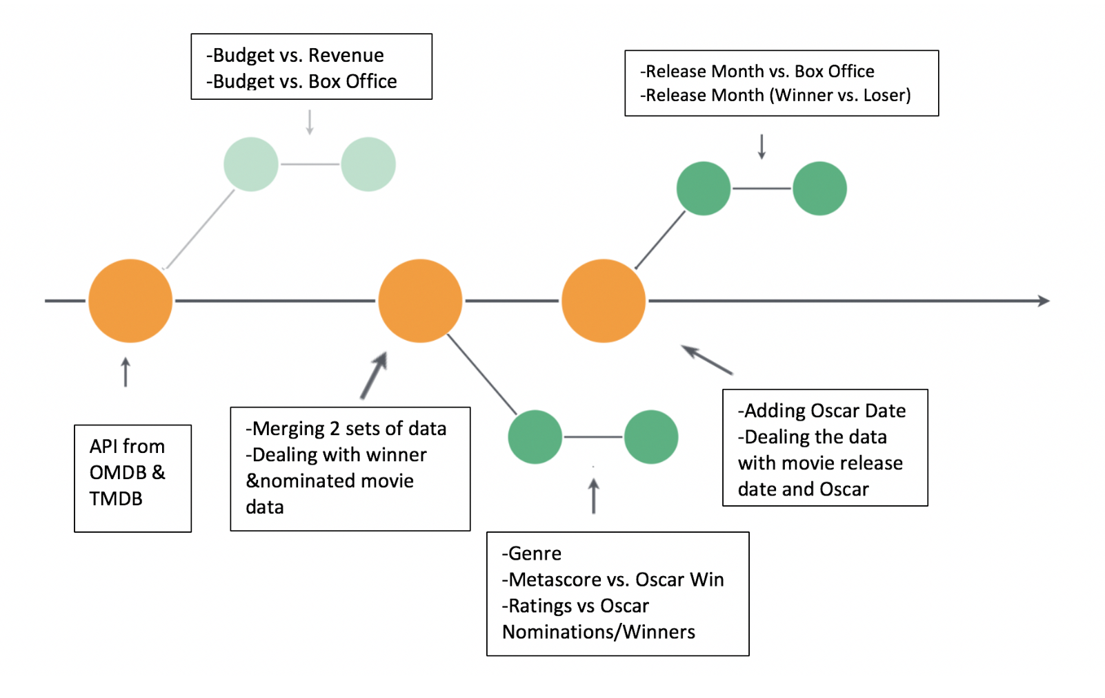
The silver screen
Datasets that were used were Kaggle, OMDB and TMDB

Slide 4
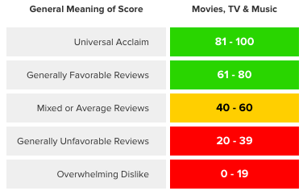
The silver screen
Metascore uses a weighted average of the world’s most respected critics.. A score of 81 or above designates the movie as a “Must See”. In the Metacritic’s database only 5% of movies achieve this score.

Slide 5
The silver screen
Picking the Oscar Winners
To be eligible for nominations in any of the feature film categories, a movie must meet these basic requirements [source: 90TH Annual Academy Awards of Merit Rules]:
It must be more than 40 minutes long.
Its public premiere must have been in a movie theater, during the appropriate calendar year.
It must have premiered in 35mm or 70mm film format or in 24-frame, progressive scan digital format.
It must have played in an L.A. County theater, for paid admission, for seven consecutive days, beginning in the appropriate calendar year.

Slide 6
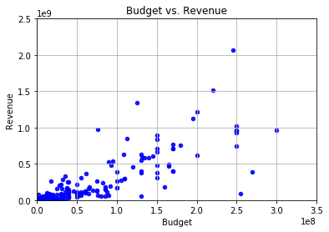
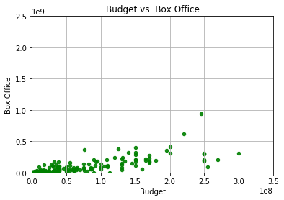
The silver screen

Slide 7
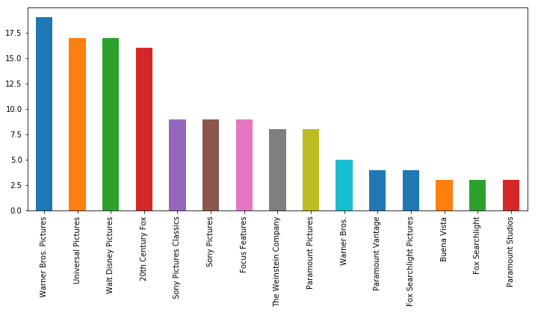
The silver screen
Top 15 Production Companies who have won Oscars

Slide 8
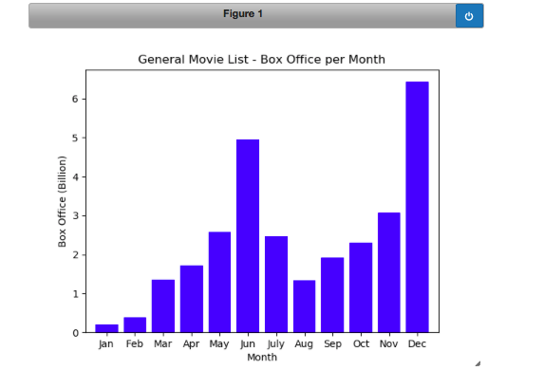
The silver screen
Release Month vs. Box Office
The data shows what months are
optimal to release feature films

Slide 9
The silver screen
Release Month (Winner vs. Loser) (Choi’s slide)

Slide 10
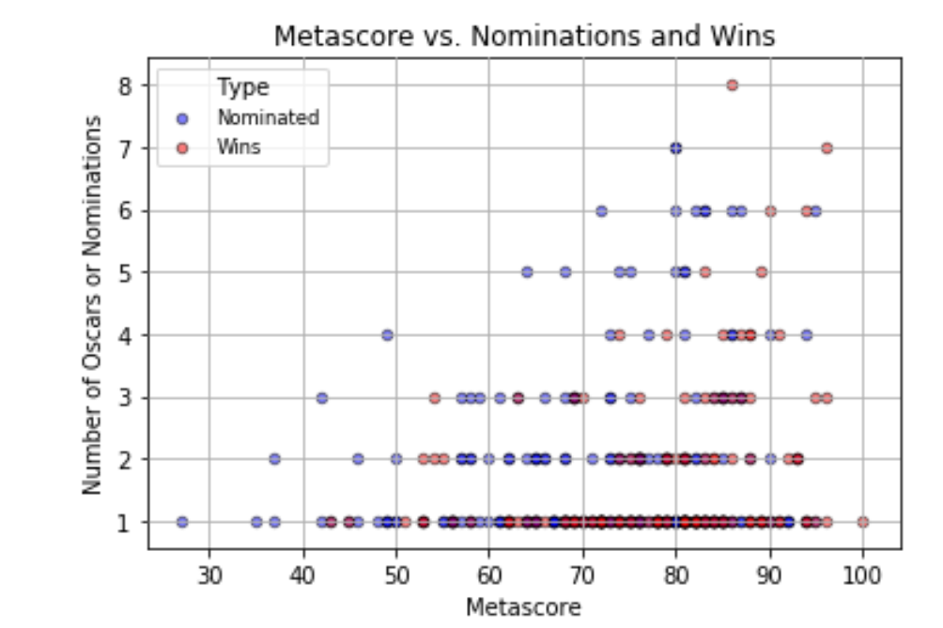
The silver screen
Metascore

Slide 11
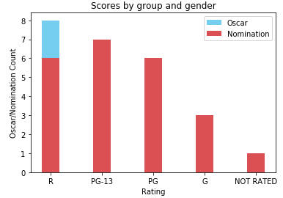
The silver screen
Ratings

